Slide 1

Azure DocumentDB
Building Web Application with ASP.NET MVC using Azure DocumentDB
陳葵懋 Ian Chen
http://codeian.idv.tw/

Slide 2
Agenda
Azure DocumentDB
HOL - Building Web Application with ASP.NET MVC using Azure DocumentDB

Slide 3
Azure DocumentDB
關聯式資料庫
SQL Database (PaaS)
SQL Server (IaaS)
NoSQL
Azure Table (Key-Value)
Azure DocumentDB (document database)

Slide 4
Azure DocumentDB
非關聯式資料庫(NoSQL document database)
JSON document
Support SQL Query
Only Self-join
LINQ-to-SQL Support for.NET

Slide 5
Azure DocumentDB
DocumentDB 是 Microsoft 提供的 Document-Based NoSQL方案，具備NoSQL資料庫的優點，但同時可以使用SQL 語法查詢資料，對於RDBMS 的使用者可以無痛學會如何查詢資料
OneNote就是使用DocumentDB來提供服務

Slide 6
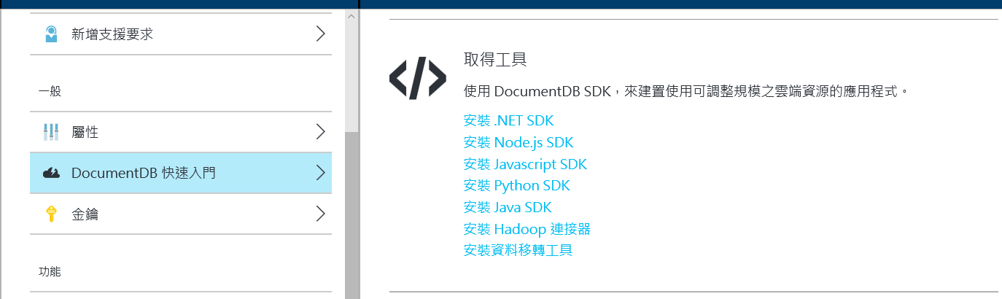
Azure DocumentDB SDK

Slide 7
Azure DocumentDB
Database Account
Database
Collection
Document
Stored Procedure
Trigger
User Def Function

Slide 8
Azure DocumentDB Dev
DocumentClient client = new DocumentClient(new Uri(_uri), _authkey)
var db = client.CreateDatabaseQuery()
.Where(d => d.Id == _dbid)
.AsEnumerable()
.FirstOrDefault();

Slide 9
Azure DocumentDB Dev
var collection = client.CreateDocumentCollectionQuery(db.SelfLink)
.Where(c => c.Id == "item")
.AsEnumerable()
.FirstOrDefault();
foreach (var item in client.CreateDocumentQuery<ToDoItem>(collection.SelfLink
, "select * from item "))
{
result.Add(item);
}

Slide 10
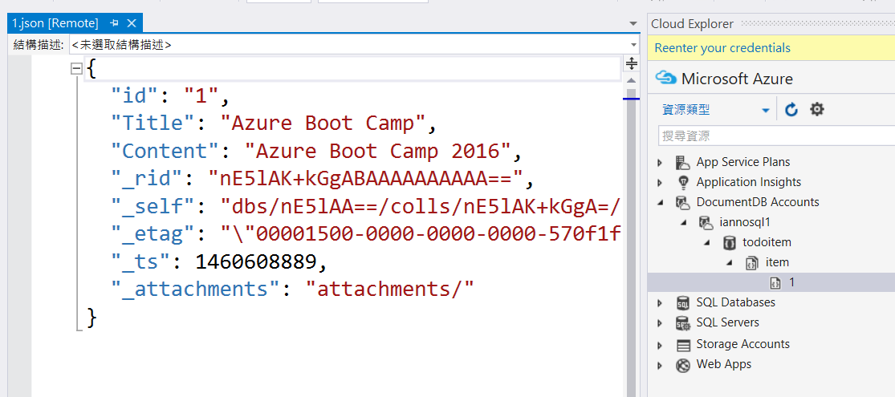
Visual Studio - Azure DocumentDB

Slide 11
Hand on Lab
Building Web Application with ASP.NET MVC using Azure DocumentDB

Slide 12
參考資源
https://azure.microsoft.com/en-us/services/documentdb/
https://azure.microsoft.com/zh-tw/documentation/articles/documentdb-faq/
https://azure.microsoft.com/zh-tw/documentation/learning-paths/documentdb/

